Slide 1
Analyzing destinations by gas price, temperature, or venue type frequency
Andrew Samarakone
October 22nd 2018

Slide 2



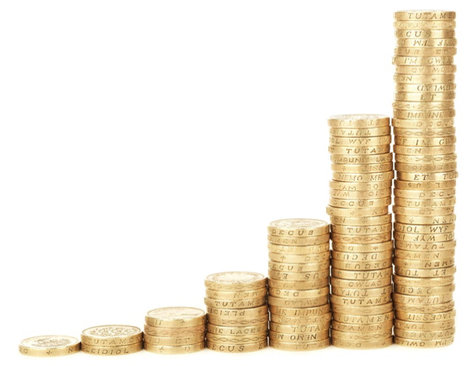
Why?
Try to figure out alternative destinations for a vacation-seeking customer
Happy vacation-seeking customer
Successful business
Images and image parts from pexels.com

Slide 3
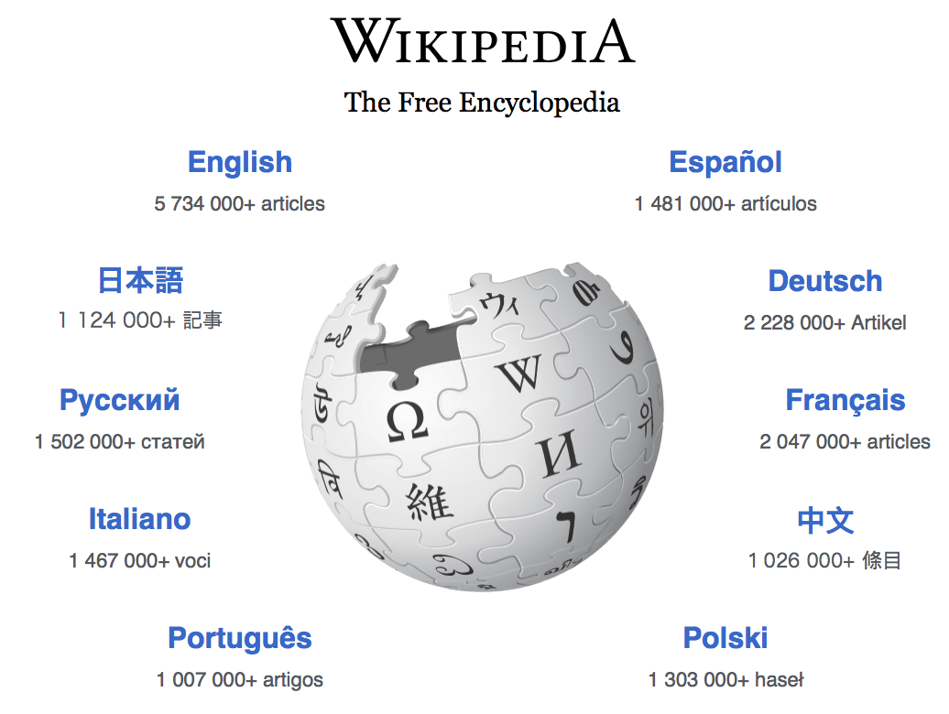



Sources of Data
Bureau of Transportation Statistics (BTS)
Wikipedia
Gas Buddy
Weather Underground
Foursquare

Slide 4
Main Methodology
Plots
Box
Scatter / Bubble
Folium map
Machine Learning Clustering Algorithms
K-Means
DBSCAN

Slide 5
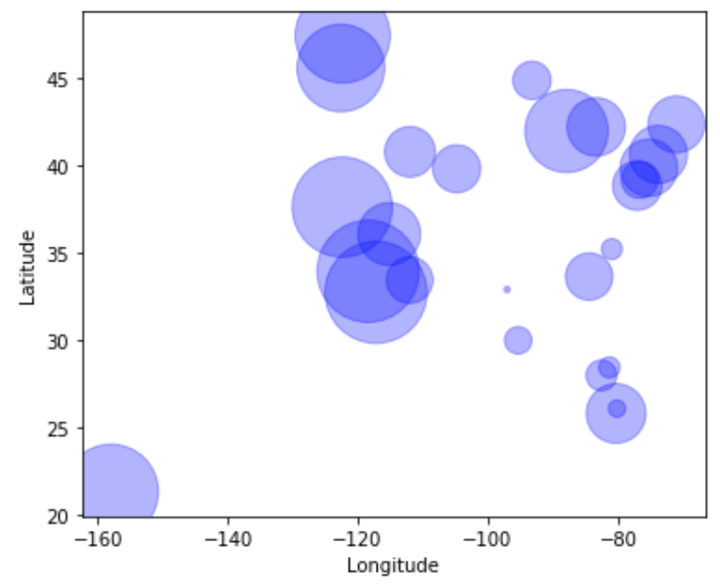
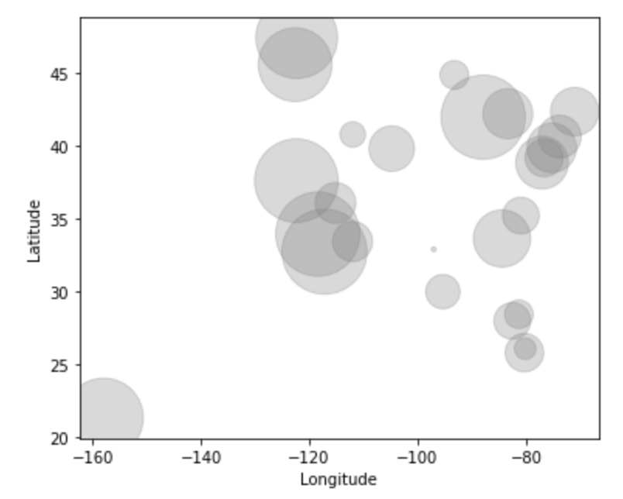
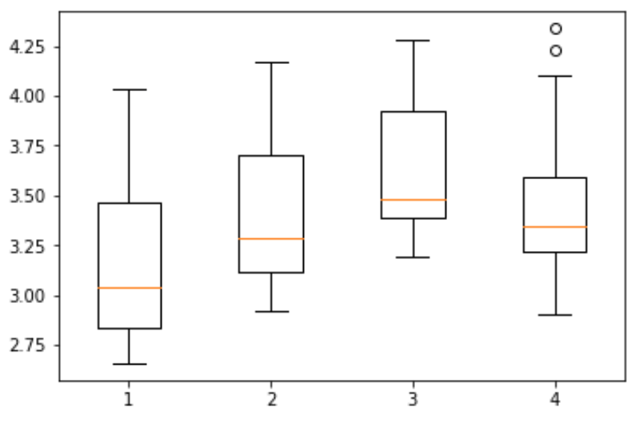
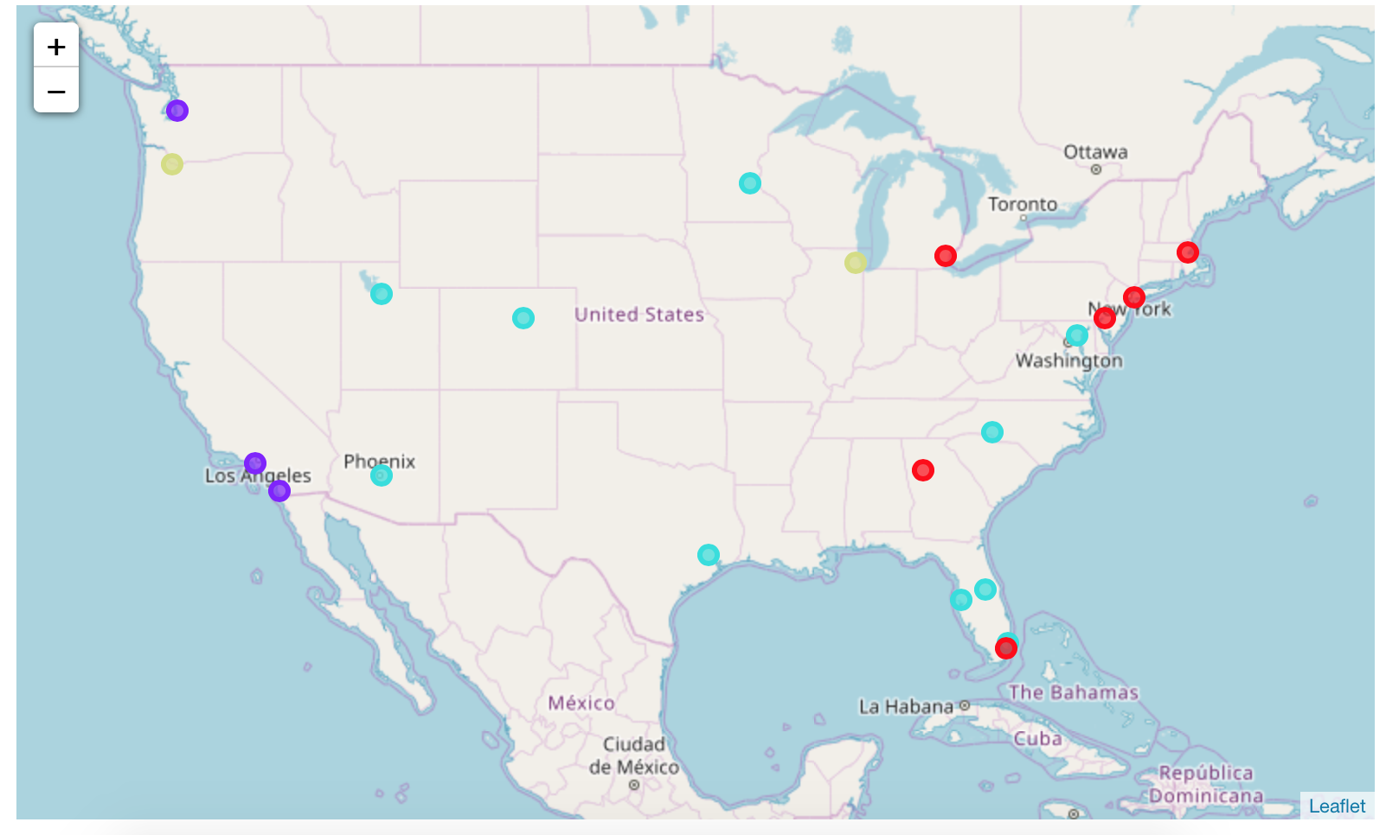
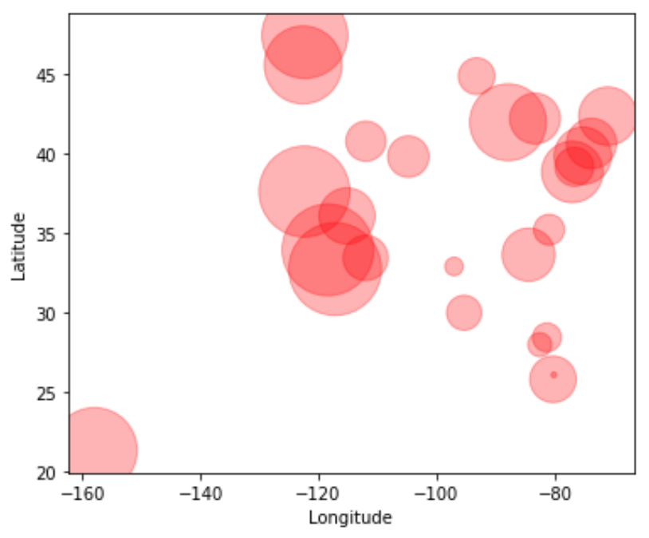
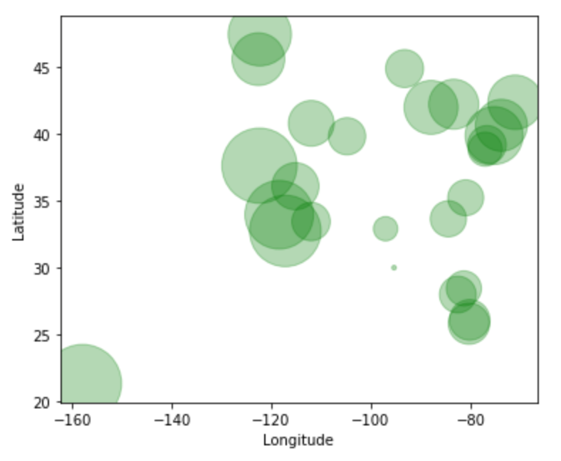
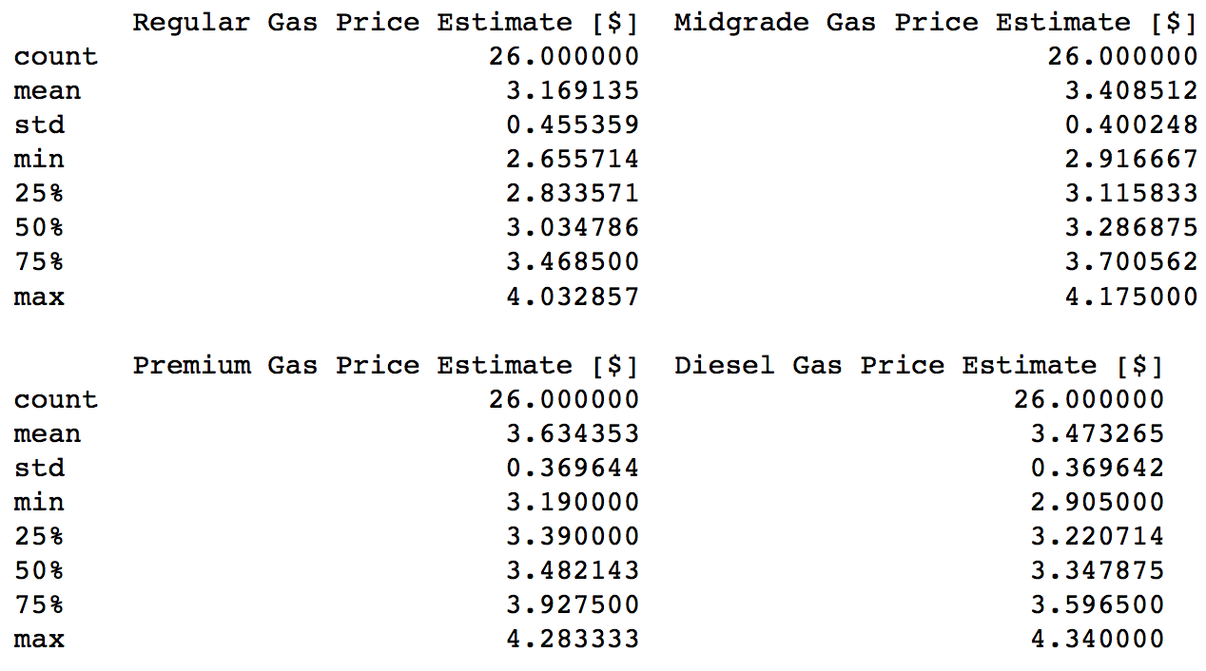
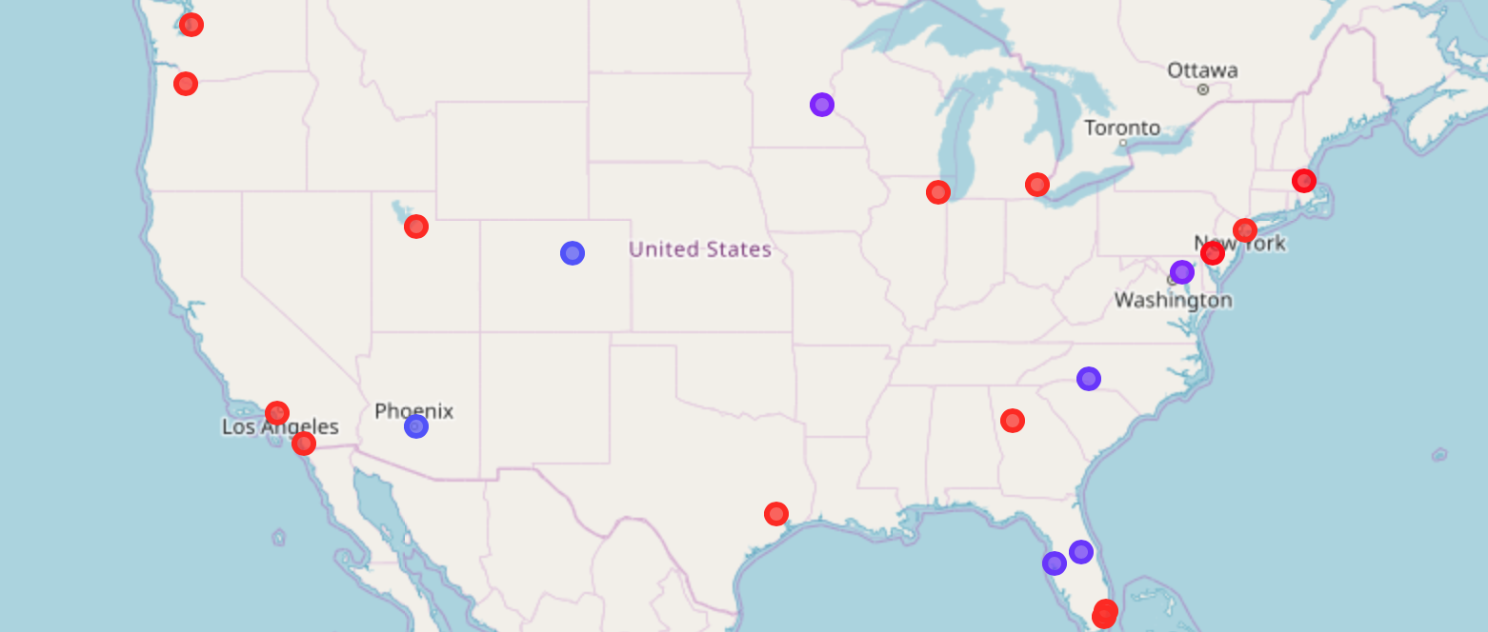
Results/Discussion
Regular
Premium
Gas Price Estimates
K Means (k = 4)
Midgrade
Diesel
DBSCAN (eps = 0.29, min_samples = 2)
Phoenix, and Denver seem to have similar gas prices
Boston and Philadelphia seem to have similar gas prices
Baltimore, Atlanta, Tampa, Minneapolis, and Orlando
seem to have similar gas prices
Example of a recommendation:
If someone wants to visit a place with similar gas prices to Minneapolis, suggest Orlando
Most of the red dots are outliers
Exceptions: Philadelphia & Boston

Slide 6
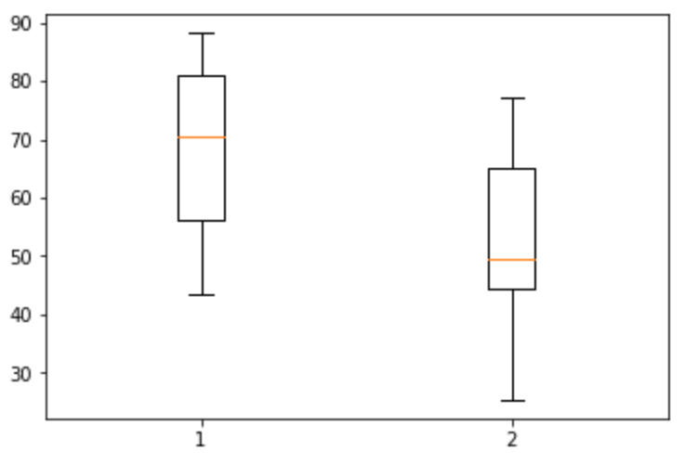
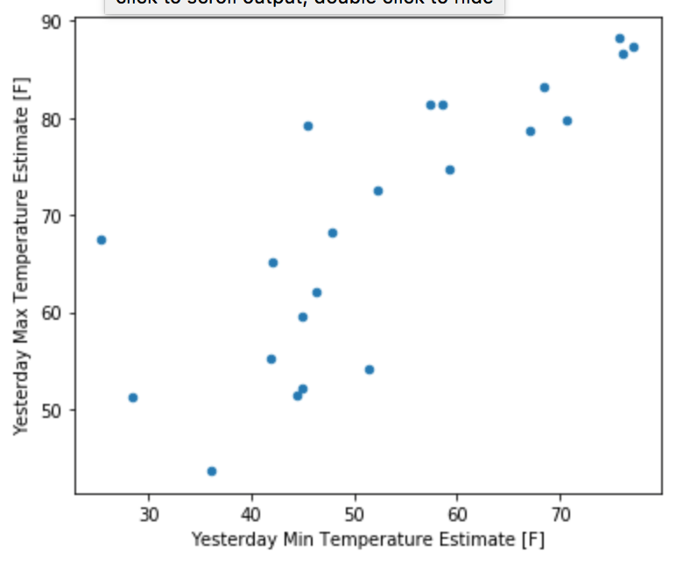
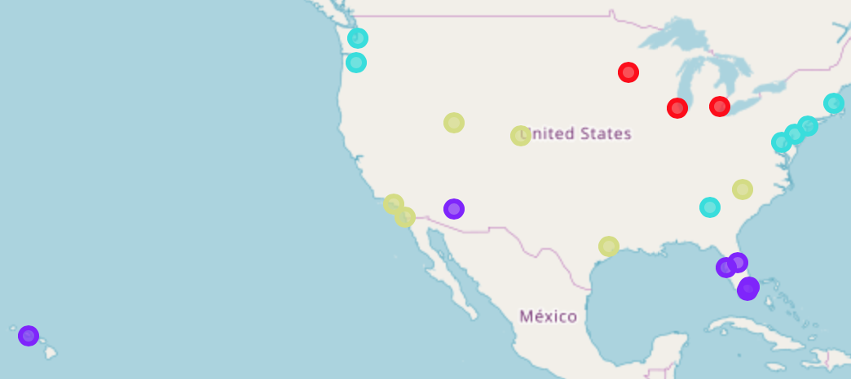
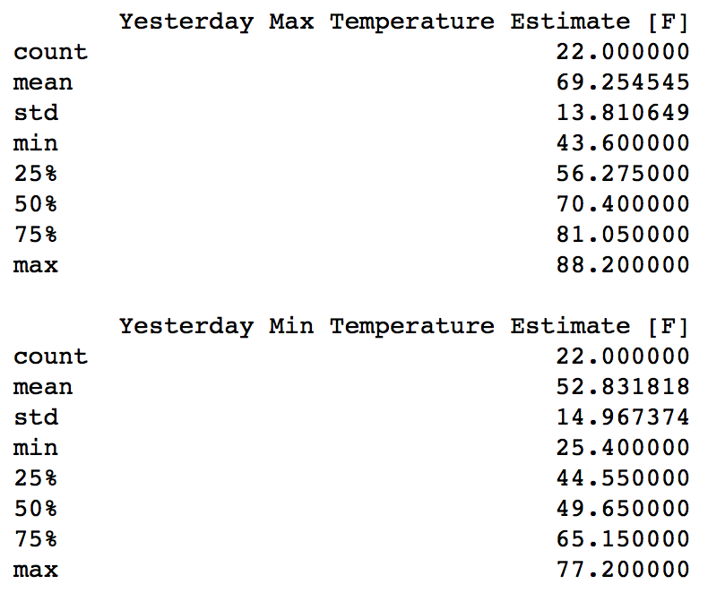
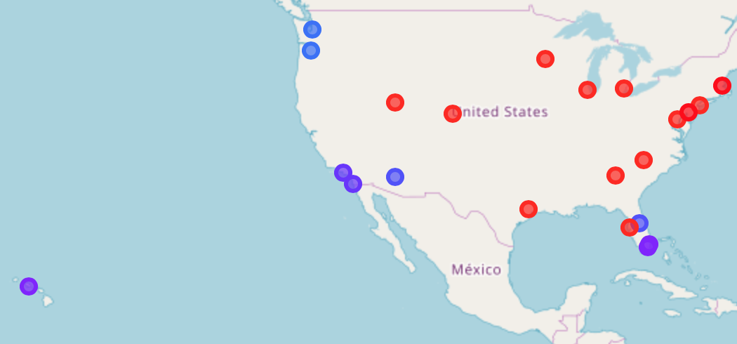
Results/Discussion (cont.)
Min/Max Temperature Estimates for Yesterday
K Means (k = 4)
DBSCAN (eps = 0.3, min_samples = 2)
Example of a recommendation:
If someone trying to book a flight for immediate departure wants to visit a place with temperature ranges like Miami, suggest Honolulu
Seattle and Portland seem to have similar temperature ranges yesterday
Boston and Philadelphia seem to have similar temperature ranges yesterday
San Diego and Los Angeles seem to have similar temperature ranges yesterday
Honolulu, Tampa, Miami, and Fort Lauderdale seem to have similar temperatures yesterday

Slide 7
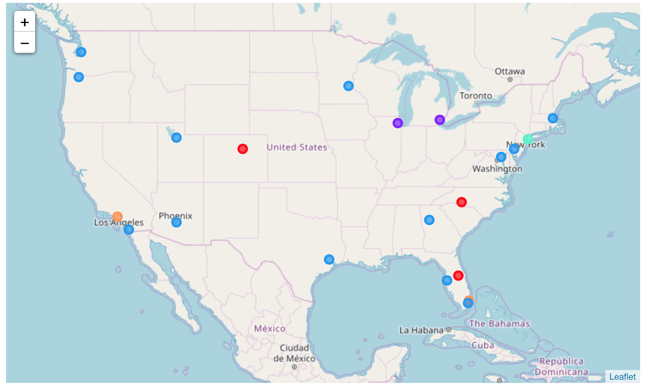
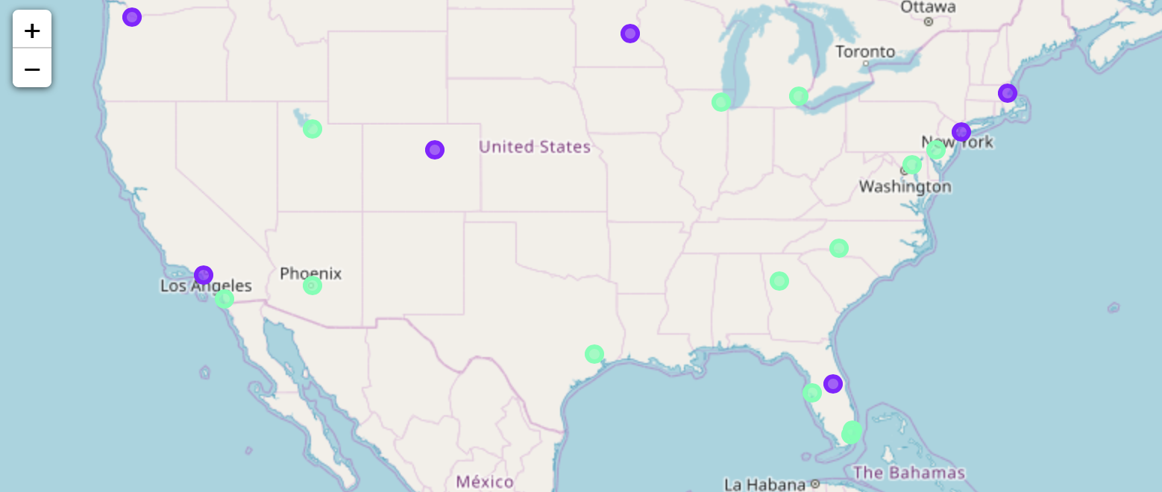
Results/Discussion (cont.)
Venue Type Frequency
K Means (k = 6)
Outliers are purple
DBSCAN (eps = 21, min_samples = 4)
Example of a recommendation:
If someone wants to visit Miami just because they liked the type of venues around, consider suggesting Phoenix (assuming they don’t care about other factors)
Vicinity of each large airport hub from Phoenix, Los Angeles, Salt Lake City, Houston, Atlanta, Tampa, Miami, Baltimore, and Philadelphia seem to have similar venue type frequencies

Slide 8
Conclusion
Need to improve project
Try to take into account other variables such as humidity, wind speed, UV, recorded incidents of flu/cold, bus pass costs, traffic, venue frequency of big brand names (e.g. Starbucks), frequency of slang words in Venue tips, etc.
Maybe look at historic data (e.g. historic temperature data) and make predictions using ML (e.g. Logistic Regression). For example, predict the probability that the temperature for the day the customer plans to arrive is between X and Y degrees Fahrenheit.

